Slide 1
CAPSTONE PROJECT
Submitted by: Leslie Anne D. Dolot
30 MARCH 2026

Slide 2

OUTLINE:
Business Problem
Our Approach
Key Findings
Results
Recommendations
Risks and Considerations
Next Steps & ROI Projection

Slide 3
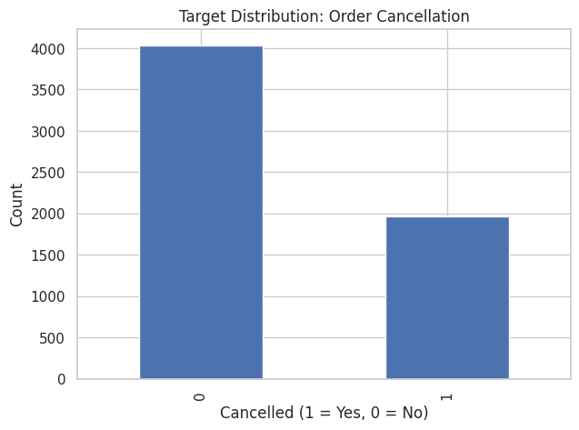
Business Problem
There are 32.32% cancelled orders in the past year from August 2024 to 2025.
The order cost of cancellations ranges from 100 to 1500 Indian Rupees.
The months of January, March, August, September and October have the highest cancellations (>500 counts)
32.32%
We lost 1,571,276.37 Indian Rupees ($ 16,624) due to order cancellations in one year.

Slide 4
Our Approach
Identify:
Which orders are likely to be cancelled before fulfillment?
Once identified:
Provide proactive interventions (discounts, faster dispatch, alerts)
Create system changes, solutions and preventive measures
Measure the savings and earnings from these interventions
Review customers’ brand loyalty and patronage

Slide 5
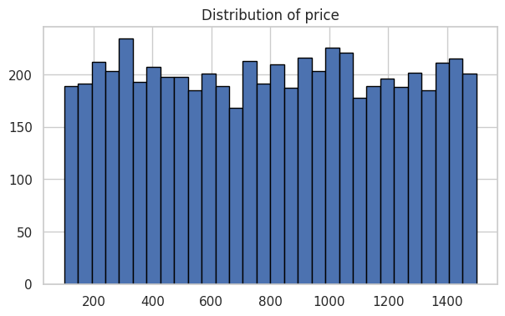
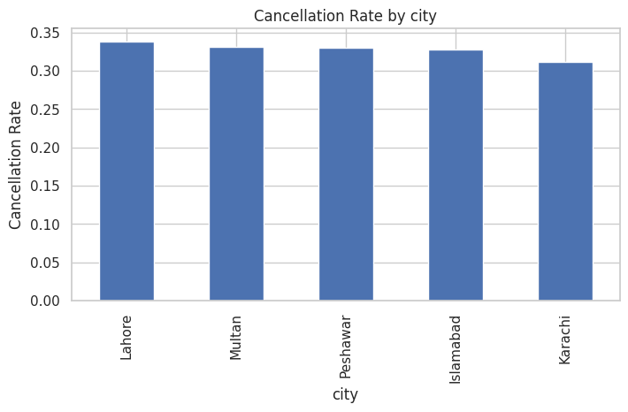
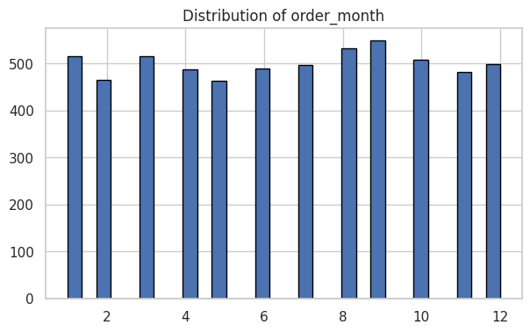
Key Findings
Cancellation happens across the full range of the transactions’ price or amount.
High cancellations (>500 counts) occurred during the months of January, March, August, September and October.
Certain locations have higher cancellations than others.

Slide 6
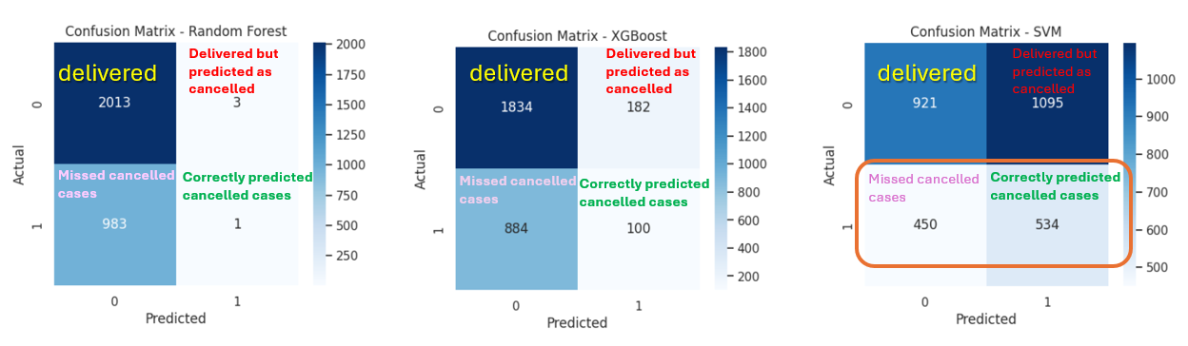
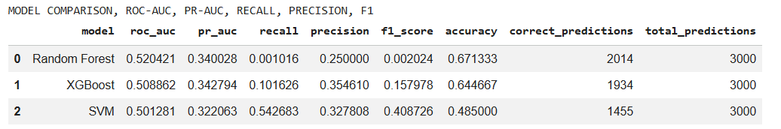
Results
Supervised Classification Algorithm is employed comparing three algorithms: Random Forest, XGBoost, and SVM to determine which model will provide the answer on which features can predict order cancellations.
→ Selected Model

Slide 7
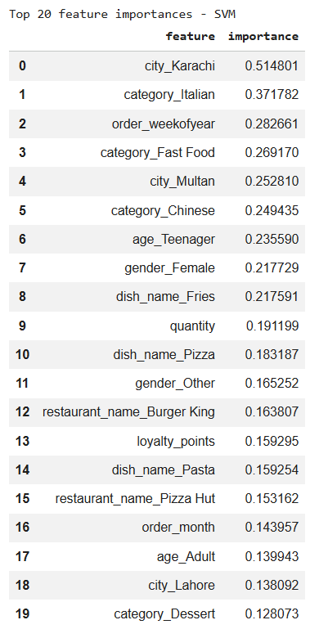
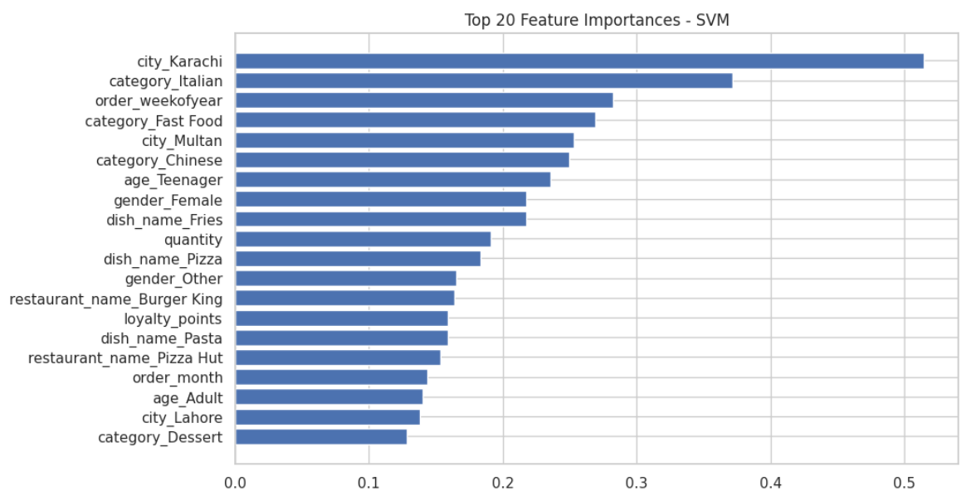
Results
the order_weekofyear, quantity, and city_Karachi are the top 3 most influential features in the data that can modestly predict cancellation of orders.

Slide 8
Recommendations
Management may schedule a more assertive interventions (promos or vouchers) during the months where high order cancellations occurs (> 500 counts) to reduce the number of cancelled orders. These are during the months of January, March, August, September, and October.
Management may provide promos of small quantity orders to encourage customers to order more quantities and reduce the possibility of cancelling the order.
To review and validate further the observed high cancellation rate on certain cities and confirm whether or not there is bias on the data or if it is real the actual reality.
To strengthen the predictive power of the model, there should be more data collected answering the following areas:
a. app’s indicated delivery time
b. time between the placement of order and the delivery (or cancellation)
c. driver assignment time (how long for the order to be assigned to a driver)
d. duration of time for the restaurant to fulfill the order
e. reason for order cancellation (availability, waiting time, rush hour, etc.)
f. types of cancellations (customer cancels due to change of mind, restaurant cancels due to out of stock, system cancels, or rider cancels)
g. other external factors (weather, road works, holidays, etc.)

Slide 9
Risks and Considerations
Address data imbalance and limitations
Some features and subsets have small data population and this may lead to skewing of data, affecting integrity of the predictive power of the model
Enlarge the dataset and cover other pertinent features
Include other features such as delivery time, reasons for cancellation, types of cancellation, and other external factors)
Watch out for biases and perform fairness audits
Based on the demographic parity test conducted, it indicated a significant disparity in predicted cancellation rates across different cities. This disparity can be addressed by adding more data points and other mitigating measures to process data.
Use of fairness metrics to mitigate biases
Review mitigations for implementation (Reweighting and post-processing)
Ensure data privacy while collecting data, and proper management of personal data in repository

Slide 10
Next Steps and ROI Projection
Once interventions are already in place, calculate the following metrics to measure business KPI:
Cancellation Rate Reduction
Prevented Cancellations
Revenue Retained
Intervention Cost vs Savings
Formula:
(New Cancellation Rate - Old Rate) / Old Rate
Objective:
Lower overall cancellations
Formula:
Prevented Cancellations = total orders saved due to intervention
Objective:
Reduce the % of cancelled orders in the same time frame as the previous data.
Formula:
Revenue Retained = ∑(value of orders where cancellation is prevented)
Objective:
The higher the value, then more revenue is generated.
Formula:
Net Benefit = Revenue Retained - Cost of Intervention
Objective:
The Net Benefit must be a positive value.

Slide 11
Thank you!

